Slide 1
Advanced Database Concepts C.Sc. 563

Slide 2
Unit 1: File Organizations and Indexes - 8 Hrs.
Files of Ordered Records
Hashing Techniques
Other Primary File Organizations
Parallelizing Disk Access Using RAID Technology
Storage Area Networks
Indexing Structures for Files
Introduction
Secondary Storage Devices
Buffering Blocks
Placing File Records on Disk
Operations on Files
Files of Unordered Records

Slide 3
Introduction
The collection of data that makes up a computerized database must be stored physically on some computer storage medium.
Computer storage media form a storage hierarchy that includes two main categories:
Primary storage: Fastest media but volatile (cache, main memory).
Secondary storage: next level in hierarchy, non-volatile, moderately fast access time
also called on-line storage
E.g. flash memory, magnetic disks
Tertiary storage: lowest level in hierarchy, non-volatile, slow access time
also called off-line storage
E.g. magnetic tape, optical storage

Slide 4
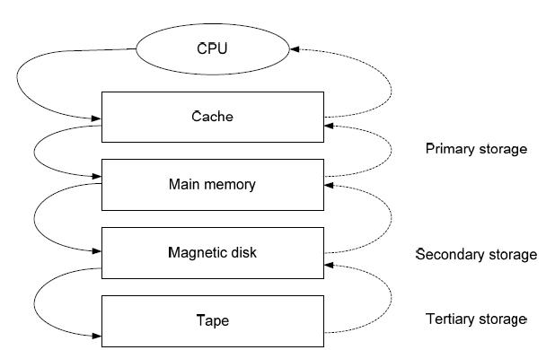
Storage Hierarchy

Slide 5
Storage of Databases
DBMS stores information on (‘hard’) disks.
This has major implications for DBMS design!
– READ: transfer data from disk to main memory
(RAM).
– WRITE: transfer data from RAM to disk.
– Both are high-cost operations, relative to in memory operations, so must be planned carefully!

Slide 6
Storage of Databases (Cont)
Why not store everything in main memory?
Costs too much.
Main memory is volatile. We want data to be saved between runs.
Typical storage hierarchy:
– Main memory (RAM) for currently used data.
– Disk for the main database.
– Tapes for archiving older versions of the data.

Slide 7
Disk Storage Devices
Preferred secondary storage device for high storage capacity and low cost.
Data stored as magnetized areas on magnetic disk surfaces.
A disk pack contains several magnetic disks connected to a rotating spindle.
Disks are divided into concentric circular tracks on each disk surface.
Track capacities vary typically from 4 to 50 Kbytes or more

Slide 8
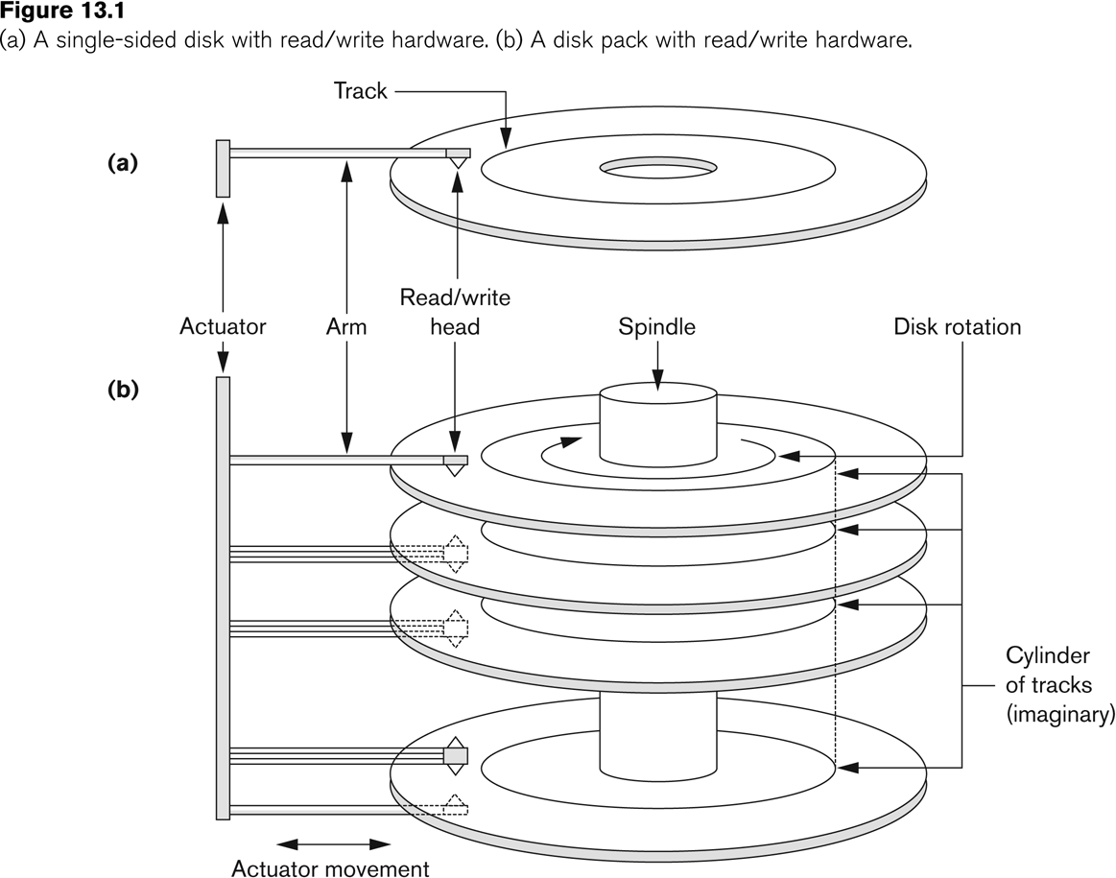
Disk Storage Devices (cont.)

Slide 9
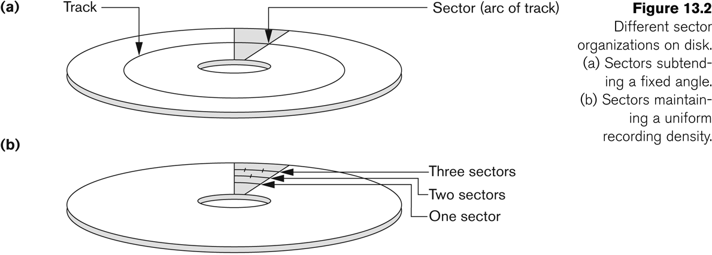
Disk Storage Devices (contd.)

Slide 10
Disk Storage Devices (contd.)
A track is divided into smaller blocks or sectors
because it usually contains a large amount of information
The division of a track into sectors is hard-coded on the disk surface and cannot be changed.
One type of sector organization calls a portion of a track that subtends a fixed angle at the center as a sector.
A track is divided into blocks.
The block size B is fixed for each system.
Typical block sizes range from B=512 bytes to B=4096 bytes.
Whole blocks are transferred between disk and main memory for processing.

Slide 11
Disk Storage Devices (contd.)
A read-write head moves to the track that contains the block to be transferred.
Disk rotation moves the block under the read-write head for reading or writing.
A physical disk block (hardware) address consists of:
a cylinder number (imaginary collection of tracks of same radius from all recorded surfaces)
the track number or surface number (within the cylinder)
and block number (within track).
Reading or writing a disk block is time consuming because of the seek time s and rotational delay (latency) rd.
Double buffering can be used to speed up the transfer of contiguous disk blocks.

Slide 12
Buffering of Blocks
When several blocks need to be transferred from disk to main memory and all the block addresses are known, several buffers can be reserved in main memory to speed up the transfer.
While one buffer is being read or written, the CPU can process data in the other buffer because an independent disk I/O processor.
Disk I/O processor can proceed to transfer a data block between memory and disk independent of and in parallel to CPU processing.

Slide 13
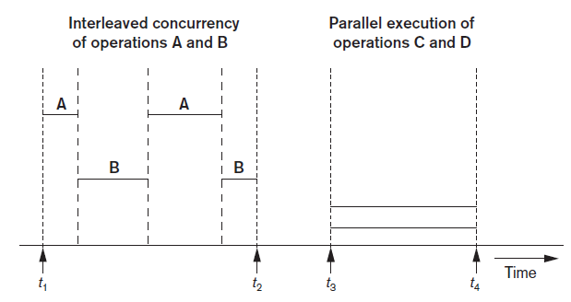
Buffering of Blocks
Buffering most useful when processes can run concurrently in parallel
Figure: Interleaved concurrency versus parallel execution

Slide 14
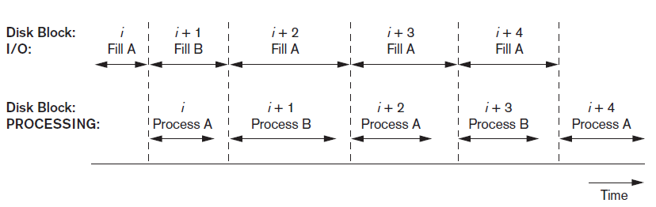
Buffering of Blocks (cont’d.)
Double buffering can be used to read continuous stream of blocks
Figure: Use of two buffers, A and B, for reading from disk

Slide 15
Records
Fixed and variable length records
Records contain fields which have values of a particular type
E.g., amount, date, time, age
Fields themselves may be fixed length or variable length
Variable length fields can be mixed into one record:
Separator characters or length fields are needed to terminate variable length fields.

Slide 16
Files of Records
A file is a sequence of records, where each record is a collection of data values (or data items).
A file descriptor (or file header) includes information that describes the file, such as the field names and their data types, and the addresses of the file blocks on disk.
Records are stored on disk blocks.
The blocking factor (bfr) for a file is the (average) number of file records stored in a disk block.
A file can have fixed-length records or variable-length records.

Slide 17
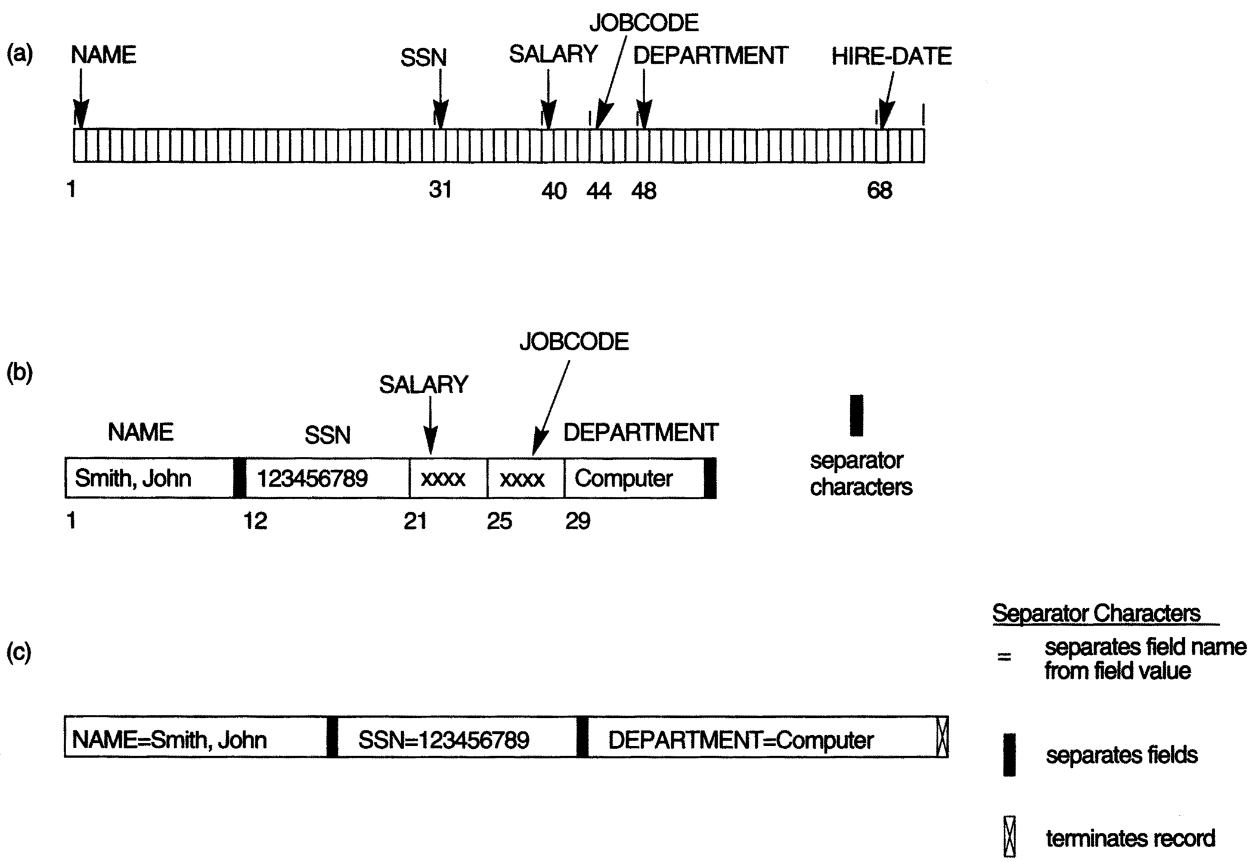
Three record storage formats. (a) A fixed-length record with six fields and size of 71 bytes. (b) A record with two variable-length fields and three fixed-length fields.

Slide 18
Blocking
The records of a file must be allocated to disk blocks because a block is the unit of data transfer between disk and memory.
When the block size is larger than the record size, each block will contain numerous records, although some files may have unusually large records that cannot fit in one block.
Suppose that the block size is B bytes. For a file of fixed-length records of size R bytes, with B ≥ R, we can fit bfr = records per block.
The value bfr is called the blocking factor for the file. In general, R may not divide B exactly, so we have some unused space in each block equal to
B − (bfr * R) bytes

Slide 19
Spanned versus Unspanned Records
To utilize this unused space, we can store part of a record on one block and the rest on another.
A pointer at the end of the first block points to the block containing the remainder of the record in case it is not the next consecutive block on disk.
This organization is called spanned because records can span more than one block.
Whenever a record is larger than a block, we must use a spanned organization.
If records are not allowed to cross block boundaries, the organization is called unspanned.
This is used with fixed-length records having B > R because it makes each record start at a known location in the block, simplifying record processing.

Slide 20
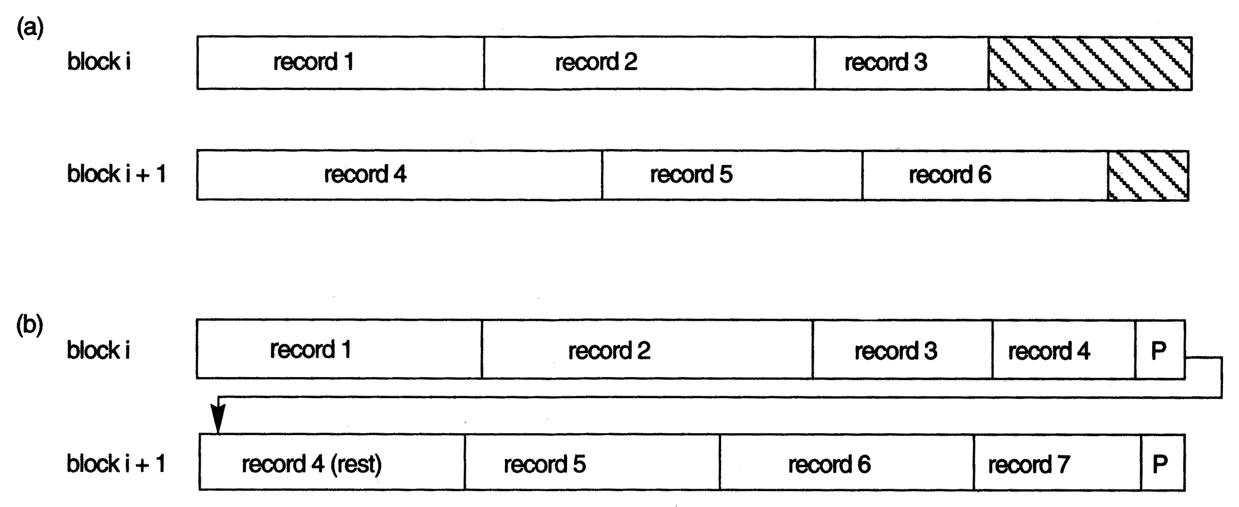
Types of record organization. (a) Unspanned (b) Spanned.

Slide 21
Record Blocking and Spanned Versus Unspanned Records (cont’d.)
Allocating file blocks on disk
Contiguous allocation
Linked allocation
Indexed allocation
File header (file descriptor)
Contains file information needed by system programs
Disk addresses
Format descriptions

Slide 22
Operation on Files
Typical file operations include:
OPEN: Readies the file for access, and associates a pointer that will refer to a current file record at each point in time.
FIND: Searches for the first file record that satisfies a certain condition, and makes it the current file record.
FINDNEXT: Searches for the next file record (from the current record) that satisfies a certain condition, and makes it the current file record.
READ: Reads the current file record into a program variable.
INSERT: Inserts a new record into the file & makes it the current file record.
DELETE: Removes the current file record from the file, usually by marking the record to indicate that it is no longer valid.
MODIFY: Changes the values of some fields of the current file record.
CLOSE: Terminates access to the file.
REORGANIZE: Reorganizes the file records.
For example, the records marked deleted are physically removed from the file or a new organization of the file records is created.
READ_ORDERED: Read the file blocks in order of a specific field of the file.

Slide 23
Files of Unordered Records (Heap Files)
Also called a heap or a pile file.
New records are inserted at the end of the file.
A linear search through the file records is necessary to search for a record.
This requires reading and searching half the file blocks on the average, and is hence quite expensive.
Record insertion is quite efficient.
Reading the records in order of a particular field requires sorting the file records.
Deletion techniques
Rewrite the block
Use deletion marker

Slide 24
Files of Ordered Records (Sorted Files)
Also called a sequential file.
File records are kept sorted by the values of an ordering field.
Insertion is expensive: records must be inserted in the correct order.
It is common to keep a separate unordered overflow (or transaction) file for new records to improve insertion efficiency; this is periodically merged with the main ordered file.
A binary search can be used to search for a record on its ordering field value.
This requires reading and searching log₂ of the file blocks on the average, an improvement over linear search.
Reading the records in order of the ordering field is quite efficient.

Slide 25
Files of Ordered Records (Sorted Files)
One option for making insertion more efficient is to keep some unused space in each block for new records. However, once this space is used up, the original problem resurfaces.
Another frequently used method is to create a temporary unordered file called an overflow or transaction file.
With this technique, the actual ordered file is called the main or master file.
New records are inserted at the end of the overflow file rather than in their correct position in the main file.
Periodically, the overflow file is sorted and merged with the master file during file reorganization.
Insertion becomes very efficient, but at the cost of increased complexity in the search algorithm.

Slide 26
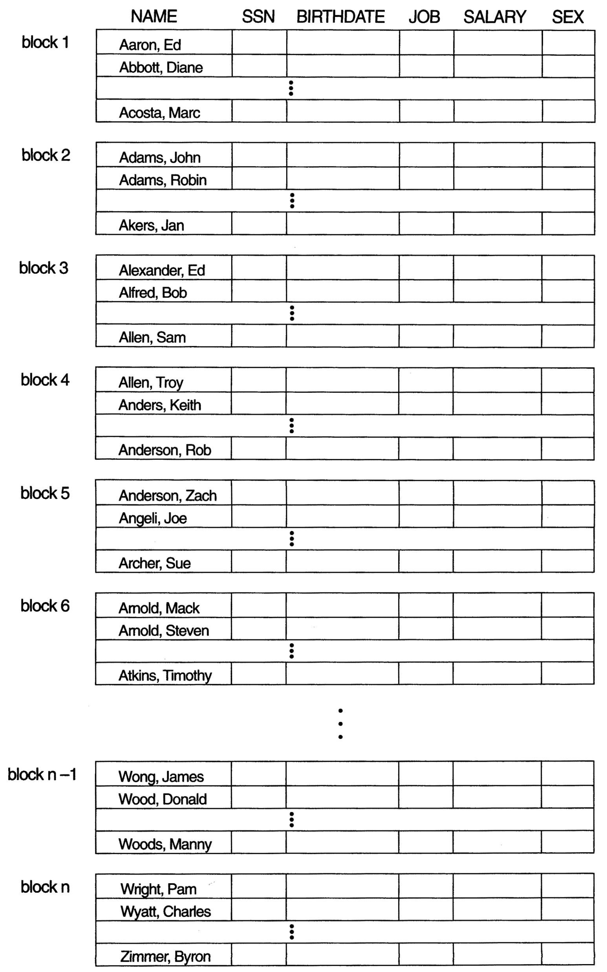
Ordered Files (contd.)

Slide 27
Hashing Techniques
Hash function (randomizing function)
Applied to hash field value of a record
Yields address of the disk block of stored record
Organization called hash file
Search condition is equality condition on the hash field
Hash field typically key field
Hashing uses internal search structure
Used when group of records accessed exclusively by one field value
The goal of a good hashing function is to distribute the records uniformly over the address space so as to minimize collisions.

Slide 28
Hashing Techniques (cont’d.)
Internal hashing
Hash table
Collision
Hash field value for inserted record hashes to address already containing a different record
Collision resolution
Open addressing
Chaining
Multiple hashing

Slide 29
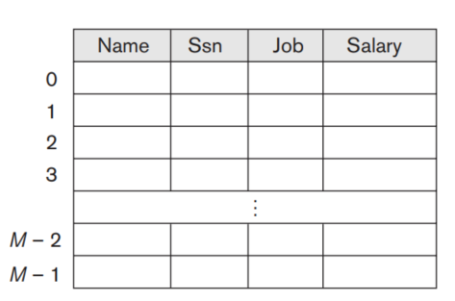
Hashing Techniques (cont’d.) – Internal Hashing
For internal files, hashing is typically implemented as a hash table through the use of an array of records.
Suppose that the array index range is from 0 to M – 1, as shown in Figure; then we have M slots whose addresses correspond to the array indexes.
We choose a hash function that transforms the hash field value into an integer between 0 and M − 1.
One common hash function is the h(K) = K mod M function, which returns the remainder of an integer hash field value K after division by M; this value is then used for the record address.
Figure: Internal hashing data structures – Array of M Positions for use in internal hashing

Slide 30
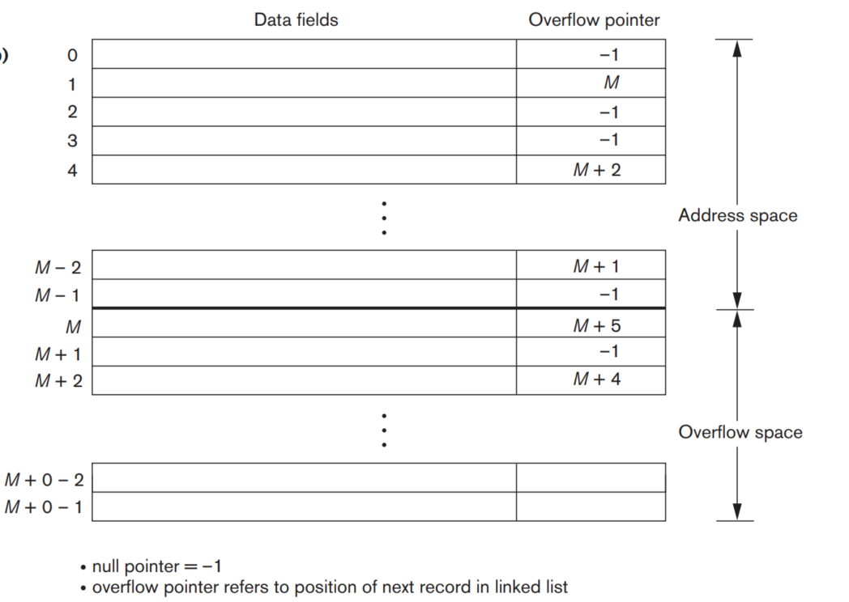
Hashing Techniques (cont’d.) – Collision resolution by chaining
Figure: Collision resolution by chaining

Slide 31
Hashed Files (contd.)
To reduce overflow records, a hash file is typically kept 70-80% full.
The hash function h should distribute the records uniformly among the buckets
Otherwise, search time will be increased because many overflow records will exist.
Main disadvantages of static external hashing:
Fixed number of buckets M is a problem if the number of records in the file grows or shrinks.
Ordered access on the hash key is quite inefficient (requires sorting the records).

Slide 32
Hashing Techniques (cont’d.) – External Hashing
External hashing for disk files
Target address space made of buckets
Bucket: one disk block or contiguous blocks
Hashing function maps a key into relative bucket
Table in file header converts bucket number to disk block address
Collision problem less severe with buckets
Static hashing
Fixed number of buckets allocated

Slide 33
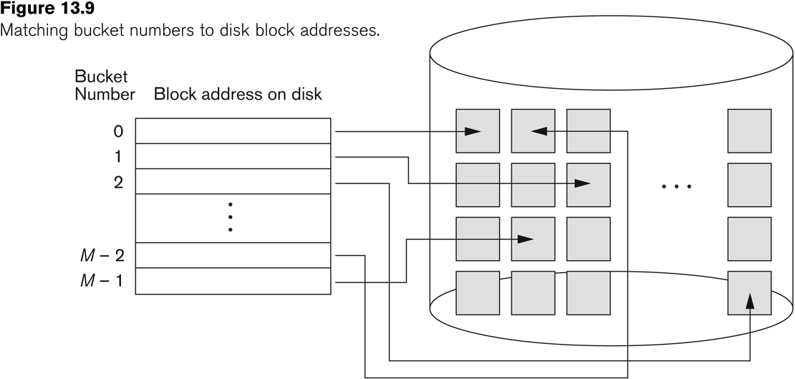
Hashed Files (contd.)
Figure: Matching bucket numbers to disk block addresses

Slide 34
Hashed Files
Hashing for disk files is called External Hashing
The file blocks are divided into M equal-sized buckets, numbered bucket₀, bucket₁, ..., bucket_{M-1}.
Typically, a bucket corresponds to one (or a fixed number of) disk block.
One of the file fields is designated to be the hash key of the file.
The record with hash key value K is stored in bucket i, where i=h(K), and h is the hashing function.
Search is very efficient on the hash key.
Collisions occur when a new record hashes to a bucket that is already full.
An overflow file is kept for storing such records.
Overflow records that hash to each bucket can be linked together.

Slide 35
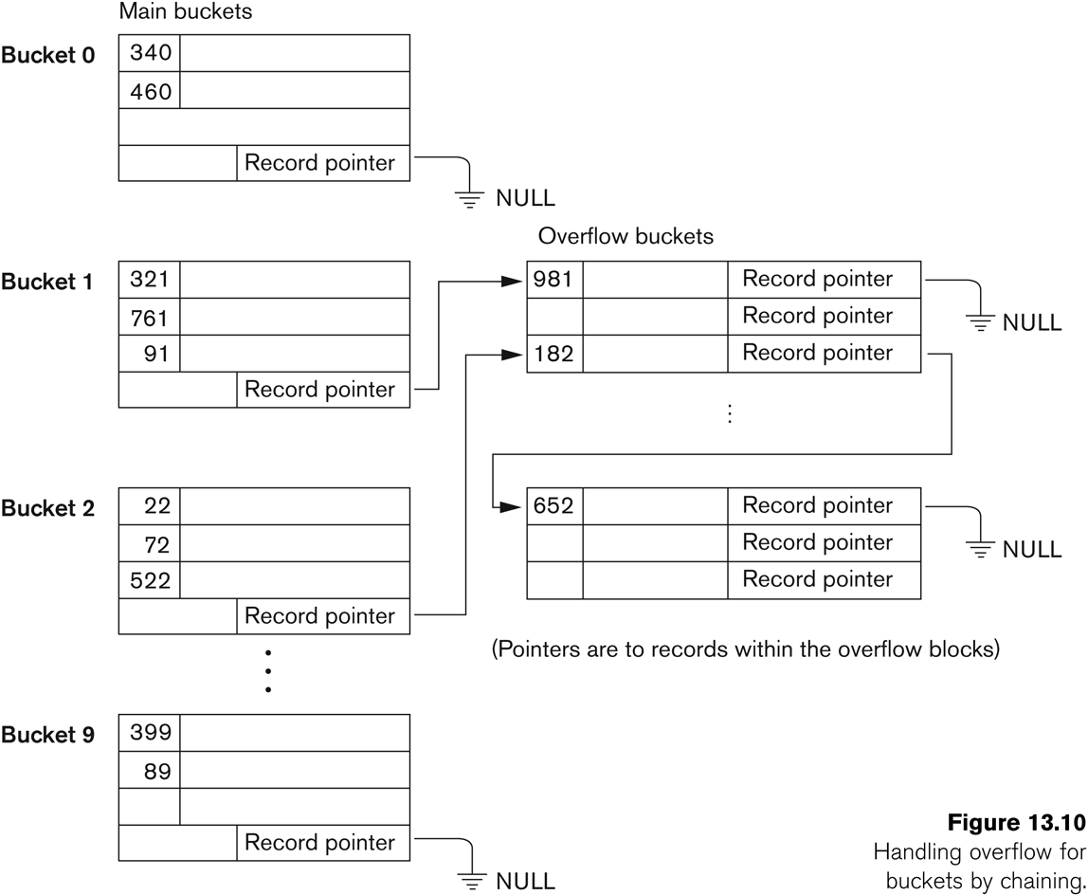
Hashed Files - Overflow handling

Slide 36
Hashing Techniques (cont’d.)
Hashing techniques that allow dynamic file expansion
Extendible hashing
File performance does not degrade as file grows
Dynamic hashing
Maintains tree-structured directory
Linear hashing
Allows hash file to expand and shrink buckets without needing a directory

Slide 37
Hashed Files (contd.)
There are numerous methods for collision resolution, including the following:
Open addressing: Proceeding from the occupied position specified by the hash address, the program checks the subsequent positions in order until an unused (empty) position is found.
Chaining: For this method, various overflow locations are kept, usually by extending the array with a number of overflow positions. In addition, a pointer field is added to each record location. A collision is resolved by placing the new record in an unused overflow location and setting the pointer of the occupied hash address location to the address of that overflow location.
Multiple hashing: The program applies a second hash function if the first results in a collision. If another collision results, the program uses open addressing or applies a third hash function and then uses open addressing if necessary.

Slide 38
Hashed Files (contd.)
To reduce overflow records, a hash file is typically kept 70-80% full.
The hash function h should distribute the records uniformly among the buckets
Otherwise, search time will be increased because many overflow records will exist.
Main disadvantages of static external hashing:
Fixed number of buckets M is a problem if the number of records in the file grows or shrinks.
Ordered access on the hash key is quite inefficient (requires sorting the records).

Slide 39
Hashed Files - Overflow handling

Slide 40
Dynamic And Extendible Hashed Files
Dynamic and Extendible Hashing Techniques
Hashing techniques are adapted to allow the dynamic growth and shrinking of the number of file records.
These techniques include the following: dynamic hashing, extendible hashing, and linear hashing.
Both dynamic and extendible hashing use the binary representation of the hash value h(K) in order to access a directory.
In dynamic hashing the directory is a binary tree.
In extendible hashing the directory is an array of size 2^{d} where d is called the global depth.

Slide 41
Dynamic And Extendible Hashing (contd.)
The directories can be stored on disk, and they expand or shrink dynamically.
Directory entries point to the disk blocks that contain the stored records.
An insertion in a disk block that is full causes the block to split into two blocks and the records are redistributed among the two blocks.
The directory is updated appropriately.
Dynamic and extendible hashing do not require an overflow area.
Linear hashing does require an overflow area but does not use a directory.
Blocks are split in linear order as the file expands.

Slide 42
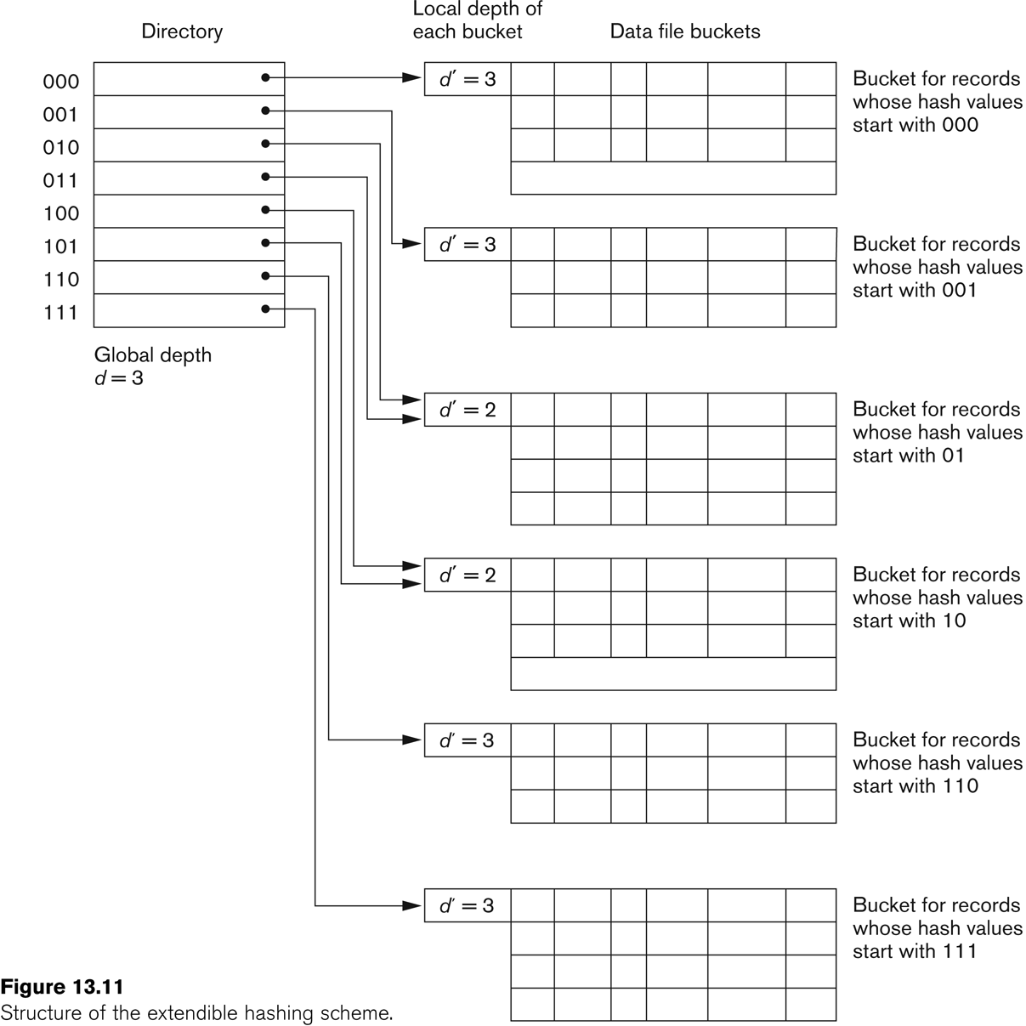
Extendible Hashing

Slide 43
Parallelizing Disk Access using RAID Technology.
Secondary storage technology must take steps to keep up in performance and reliability with processor technology.
A major advance in secondary storage technology is represented by the development of RAID, which originally stood for Redundant Arrays of Inexpensive Disks.
The main goal of RAID is to even out the widely different rates of performance improvement of disks against those in memory and microprocessors.

Slide 44
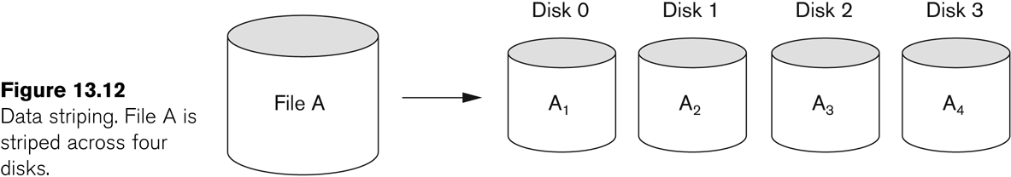
RAID Technology (contd.)
A natural solution is a large array of small independent disks acting as a single higher-performance logical disk.
A concept called data striping is used, which utilizes parallelism to improve disk performance.
Data striping distributes data transparently over multiple disks to make them appear as a single large, fast disk.

Slide 45
RAID Technology (contd.)
Different raid organizations were defined based on different combinations of the two factors of granularity of data interleaving (striping) and pattern used to compute redundant information.
Raid level 0 has no redundant data and hence has the best write performance at the risk of data loss
Raid level 1 uses mirrored disks.
Raid level 2 uses memory-style redundancy by using Hamming codes, which contain parity bits for distinct overlapping subsets of components. Level 2 includes both error detection and correction.
Raid level 3 uses a single parity disk relying on the disk controller to figure out which disk has failed.
Raid Levels 4 and 5 use block-level data striping, with level 5 distributing data and parity information across all disks.
Raid level 6 applies the so-called P + Q redundancy scheme using Reed-Soloman codes to protect against up to two disk failures by using just two redundant disks.

Slide 46
Use of RAID Technology (contd.)
Different raid organizations are being used under different situations
Raid level 1 (mirrored disks) is the easiest for rebuild of a disk from other disks
It is used for critical applications like logs
Raid level 2 uses memory-style redundancy by using Hamming codes, which contain parity bits for distinct overlapping subsets of components.
Level 2 includes both error detection and correction.
Raid level 3 (single parity disks relying on the disk controller to figure out which disk has failed) and level 5 (block-level data striping) are preferred for Large volume storage, with level 3 giving higher transfer rates.
Most popular uses of the RAID technology currently are:
Level 0 (with striping), Level 1 (with mirroring) and Level 5 with an extra drive for parity.
Design Decisions for RAID include:
Level of RAID, number of disks, choice of parity schemes, and grouping of disks for block-level striping.

Slide 47
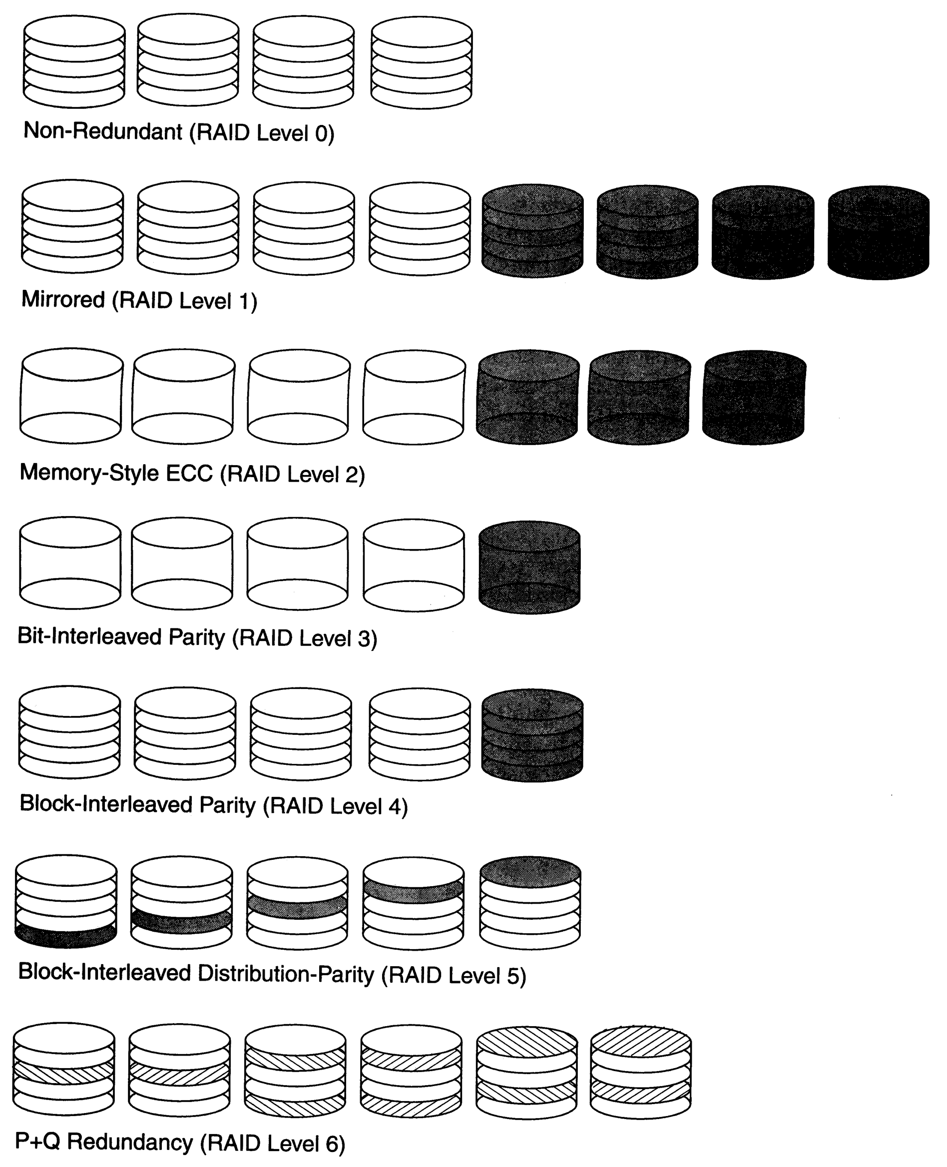
Use of RAID Technology (contd.)

Slide 48
Storage Area Networks
The demand for higher storage has risen considerably in recent times.
Organizations have a need to move from a static fixed data center oriented operation to a more flexible and dynamic infrastructure for information processing.
Thus they are moving to a concept of Storage Area Networks (SANs).
In a SAN, online storage peripherals are configured as nodes on a high-speed network and can be attached and detached from servers in a very flexible manner.
This allows storage systems to be placed at longer distances from the servers and provide different performance and connectivity options.

Slide 49
Storage Area Networks (contd.)
Advantages of SANs are:
Flexible many-to-many connectivity among servers and storage devices using fiber channel hubs and switches.
Up to 10km separation between a server and a storage system using appropriate fiber optic cables.
Better isolation capabilities allowing non-disruptive addition of new peripherals and servers.
SANs face the problem of combining storage options from multiple vendors and dealing with evolving standards of storage management software and hardware.

Slide 50
Summary
Disk Storage Devices
Files of Records
Operations on Files
Unordered Files
Ordered Files
Hashed Files
Dynamic and Extendible Hashing Techniques
RAID Technology

Slide 51
Concepts of Indexing
Indexing mechanisms speed up access to desired data
Records are physically
stored in a hash table
based on a selected key
A table
(conceptual)
Index 1
(Ordered indices, B-tree, hash)
Index 2
(Ordered indices, B-tree, hash)

Slide 52
Concepts of Indexing
The index is a type of data structure having only two columns.
The first column comprises a copy of the primary or candidate key of a table.
Its second column contains a set of pointers for holding the address of the disk block where that specific key value stored.
An Index takes a search key as input and efficiently returns a collection of matching records.
Search Key | Pointer (Data Reference)

Slide 53
Indexing: Advantages and Disadvantages
Advantages of indexing are as follows:
Better performance of queries.
Fast searching from the database.
Fast retrieval of data.
Increase performance in SELECT query.
Disadvantages of indexing are as follows:
Indexing takes more space.
Decrease performance in INSERT, DELETE and UPDATE query

Slide 54
Indexing: Types
Indexing
Secondary Indexing
Cluster Indexing
Multilevel Indexing
Spare Indexing
Dense Indexing
Single Level Indexing
Primary Indexing

Slide 55
Single level Indexing: Methods
Ordered file
Primary Index
Unordered file
Secondary Index
Secondary Index
Clustered Index
Non-Key
Key

Slide 56
Concepts of Indexing
Primary Index: Primary index is defined on an ordered data file. The data file is ordered on a key field. The key field is generally the primary key of the relation. It may be either dense or sparse.
Dense Index:
In dense index, there is an index record for every search key value in the database.
This makes searching faster but requires more space to store index records itself.
Index records contain search key value and a pointer to the actual record on the disk.
Sparse Index:
In sparse index, index records are not created for every search key.
An index record here contains a search key and an actual pointer to the data on the disk.
To search a record, we first proceed by index record and reach at the actual location of the data. If the data we are looking for is not where we directly reach by following the index, then the system starts sequential search until the desired data is found.

Slide 57
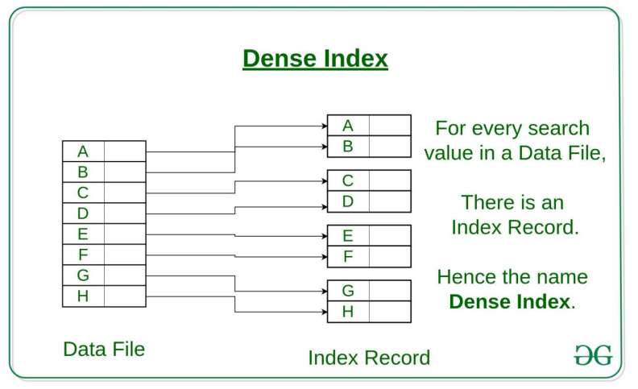
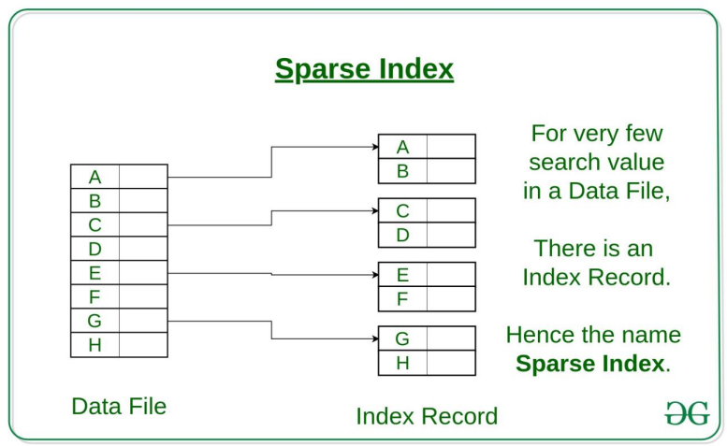
Concepts of Indexing

Slide 58
Types of Single-Level Indexes
Primary Index
Defined on an ordered data file
The data file is ordered on a key field
Includes one index entry for each block in the data file; the index entry has the key field value for the first record in the block, which is called the block anchor
A similar scheme can use the last record in a block.
A primary index is a nondense (sparse) index, since it includes an entry for each disk block of the data file and the keys of its anchor record rather than for every search value.

Slide 59
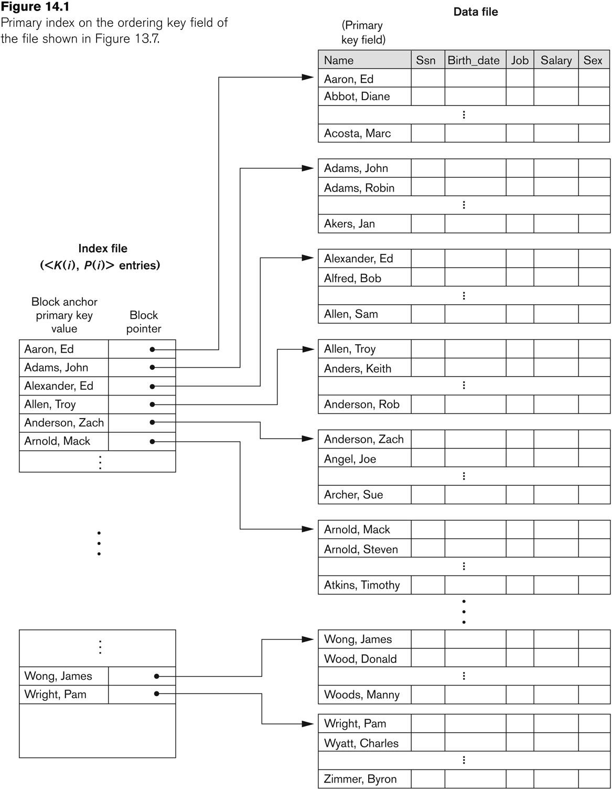
Primary index on the ordering key field
Figure: Primary Index on the ordering key field of the file

Slide 60
Types of Single-Level Indexes
Clustering Index
Defined on an ordered data file
The data file is ordered on a non-key field unlike primary index, which requires that the ordering field of the data file have a distinct value for each record.
Includes one index entry for each distinct value of the field; the index entry points to the first data block that contains records with that field value.
It is another example of nondense index where Insertion and Deletion is relatively straightforward with a clustering index.

Slide 61
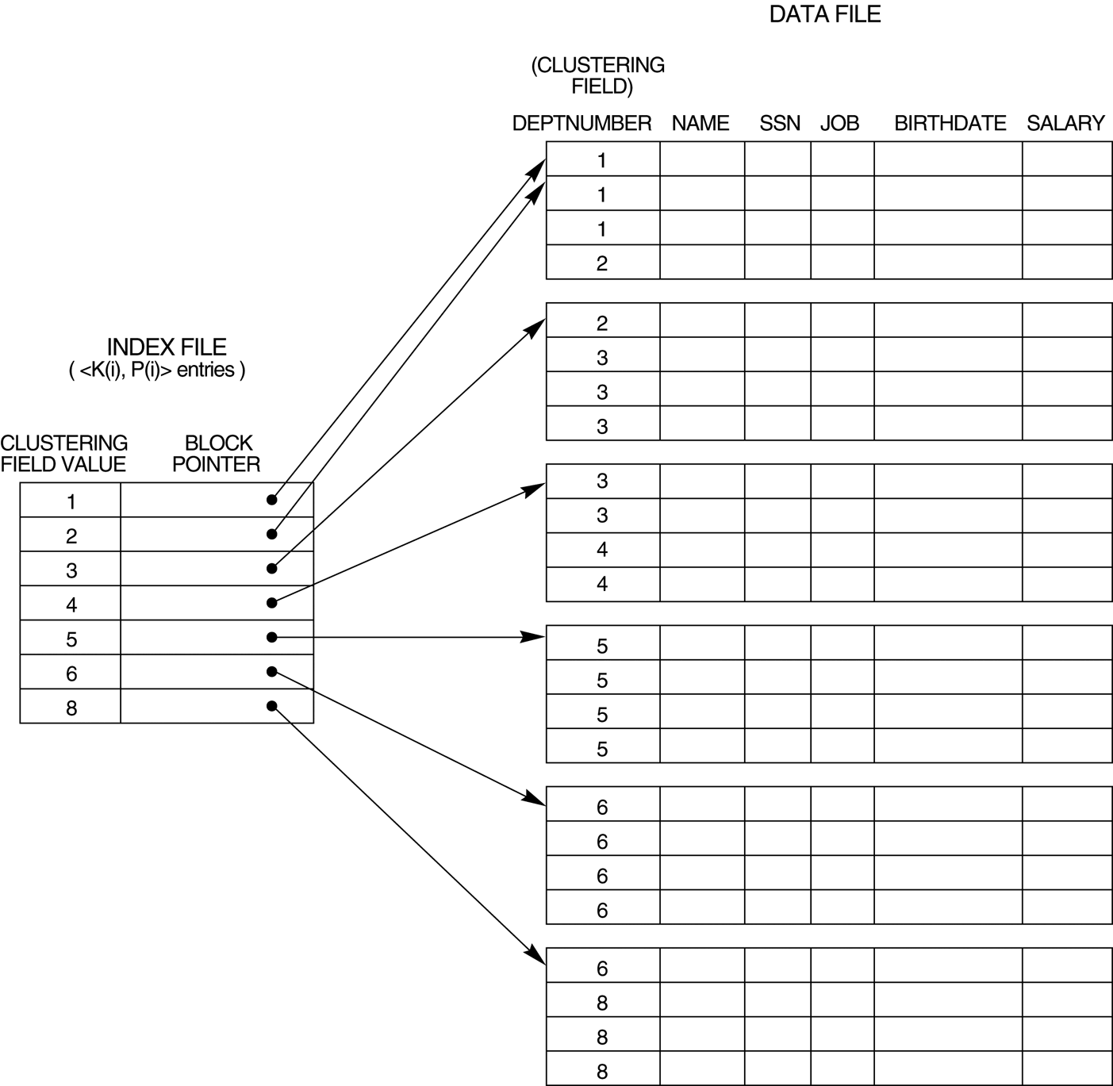
A Clustering Index Example
FIGURE : A clustering index on the DEPTNUMBER ordering non-key field of an EMPLOYEE file.

Slide 62
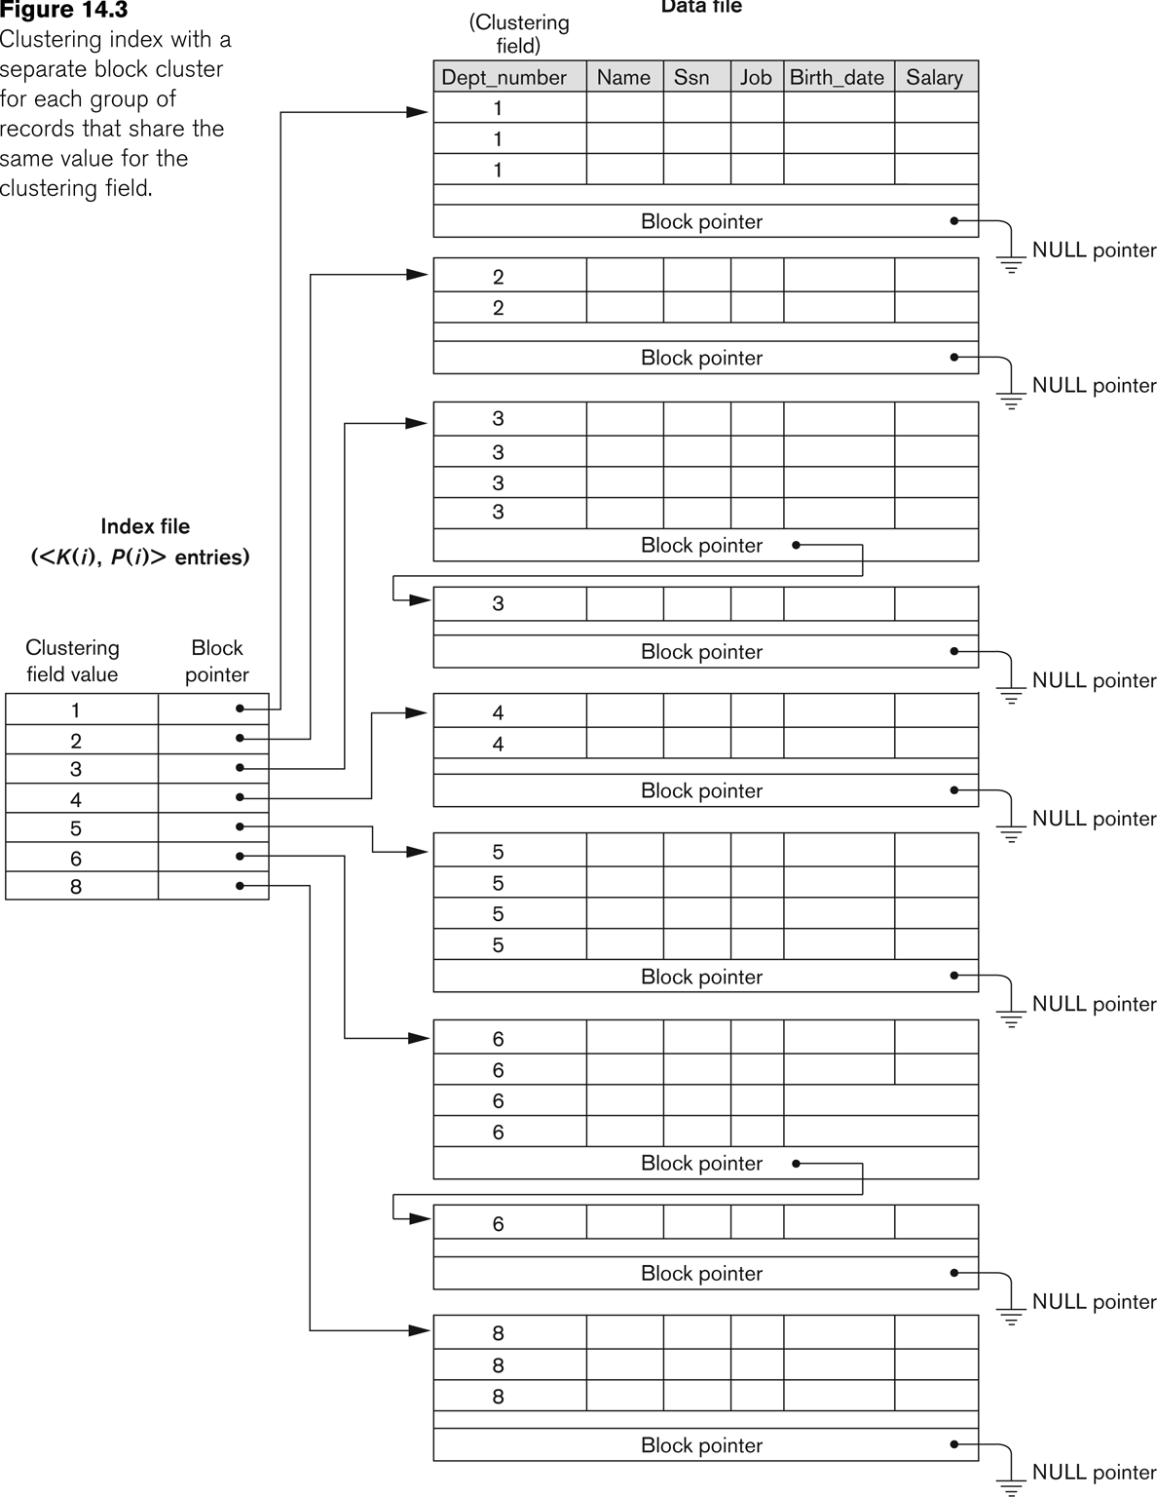
Another Clustering Index Example
Figure : Clustering index with a separate block cluster for each group of records tat share the same value for the clustering field.

Slide 63
Types of Single-Level Indexes
Secondary Index
A secondary index provides a secondary means of accessing a file for which some primary access already exists.
The secondary index may be on a field which is a candidate key and has a unique value in every record, or a non-key with duplicate values.
The index is an ordered file with two fields.
The first field is of the same data type as some non-ordering field of the data file that is an indexing field.
The second field is either a block pointer or a record pointer.
There can be many secondary indexes (and hence, indexing fields) for the same file.
Includes one entry for each record in the data file; hence, it is a dense index

Slide 64
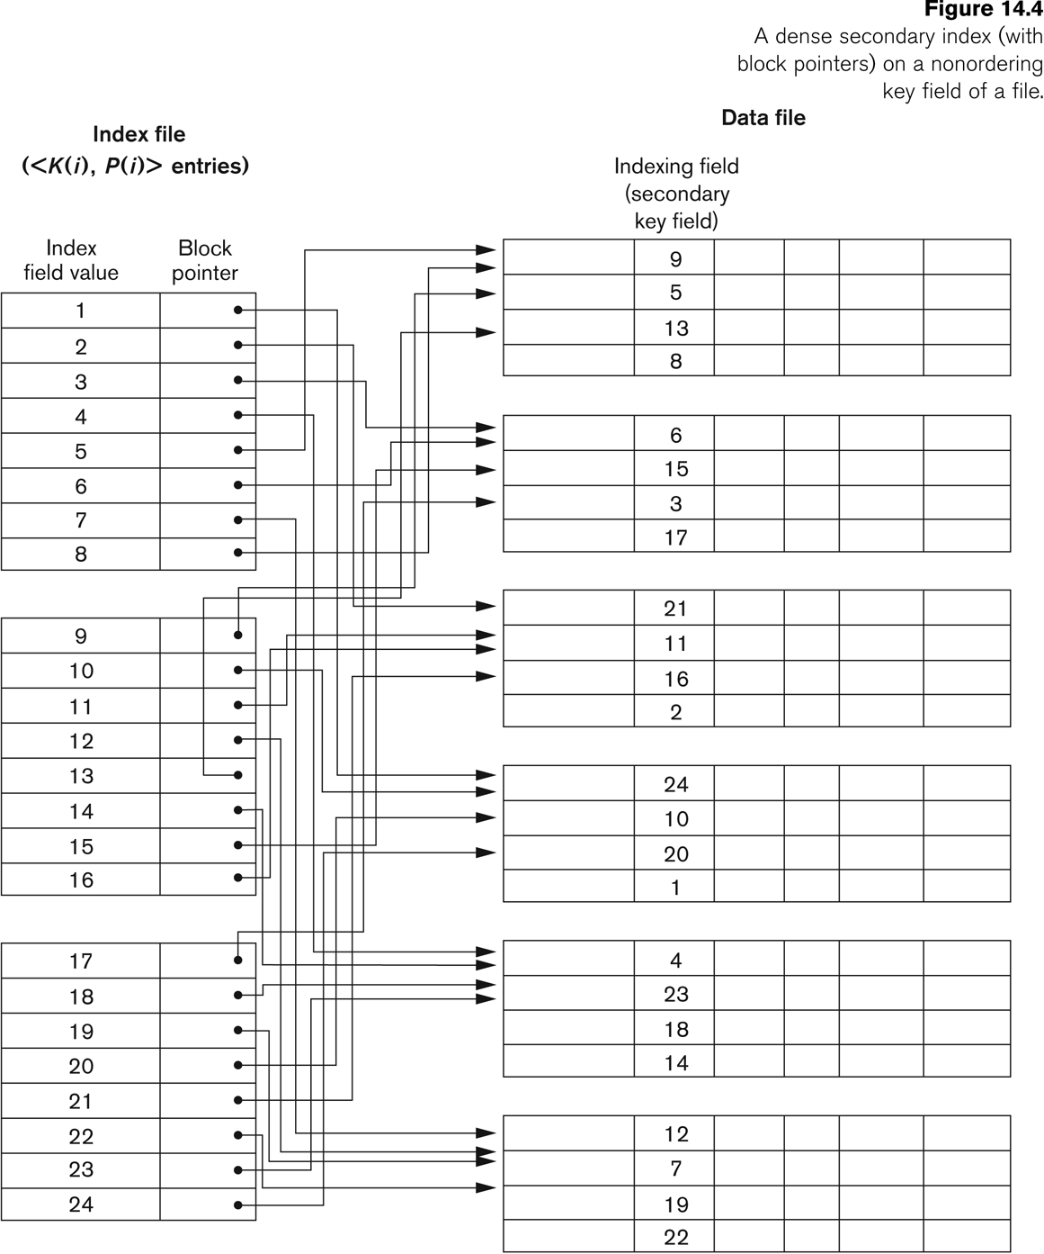
Example of a Dense Secondary Index
Figure: A dense secondary index (with block pointers) on a nonordering key field of a file.

Slide 65
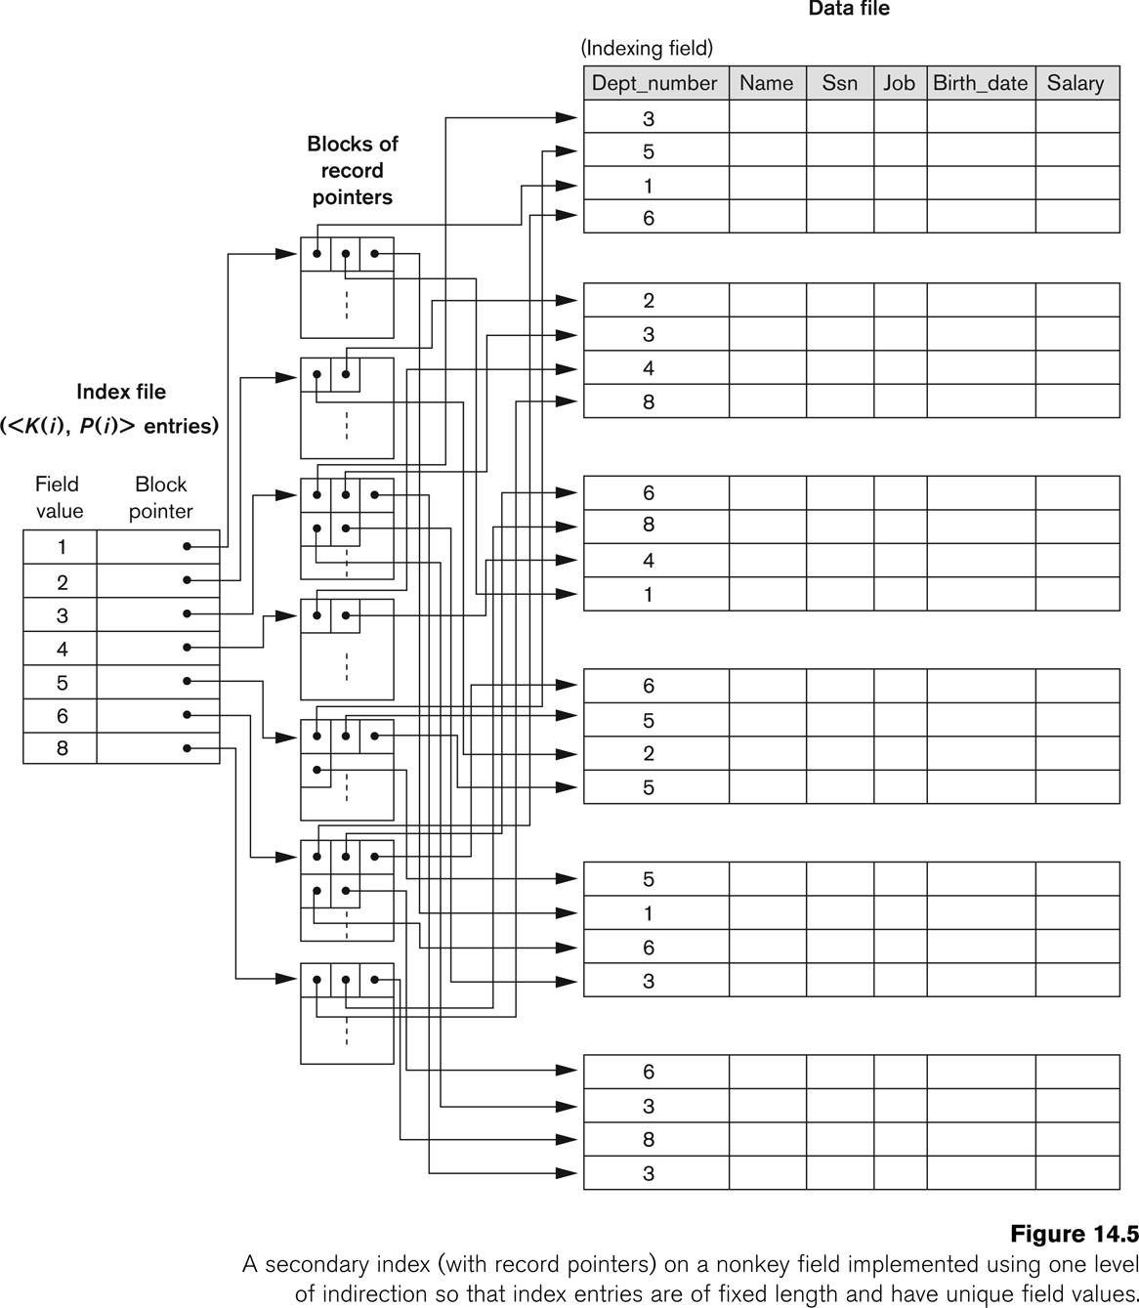
An Example of a Secondary Index
Figure: A secondary index (with record pointers) on a nonkey field implemented using one level of indirection so that index entries are of fixed length and have unique field values.

Slide 66
Multi-Level Indexes
Because a single-level index is an ordered file, we can create a primary index to the index itself;
In this case, the original index file is called the first-level index and the index to the index is called the second-level index.
We can repeat the process, creating a third, fourth, ..., top level until all entries of the top level fit in one disk block
A multi-level index can be created for any type of first-level index (primary, secondary, clustering) as long as the first-level index consists of more than one disk block

Slide 67
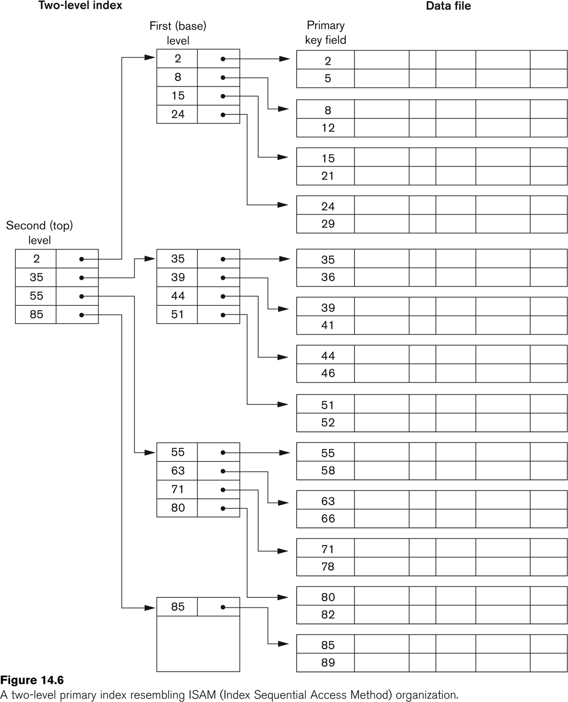
A Two-level Primary Index
Figure: A two-level primary index resembling ISAM(Index Sequential Access Method) organization.

Slide 68
Multi-Level Indexes
Such a multi-level index is a form of search tree
However, insertion and deletion of new index entries is a severe problem because every level of the index is an ordered file.

Slide 69
File Organization and Indexing
Thank you very much

